Slide 1
PowerShell Lucene
Or Everything You Know is (a little bit) Wrong
Bruce Payette
Principal Developer,
Cloud and Enterprise Division
Microsoft Corp.

Slide 2
Overview
Introduction to Lucene
Demos
Questions

Slide 3
What is Lucene
Apache Lucene is a “full-text” search engine
Indexes every word in an entry
It is an Apache project written in Java
We’re looking at Lucene.net variant which is largely compatible with the Java version.
Single machine, in process, “NoSQL” database
High availability is done in the layer above Lucene (SOLR, Elastic Search, etc.)
Indexes can be built in memory or on the file system
Allows very simple queries; provides it’s own simple query language.
We’ll look at these later.

Slide 4
Lucene Glossary
Ingestion
bringing a piece of text into the index
The Index
the searchable database of entries.
Analyzer
a piece of software that processes a raw piece of text into the form where it can be indexed
Several default analysers are provided
Can create custom analyzers
Indexing
adding an analyzed piece of text to the index
Querying
using the Lucene query language to retrieve a set of results from the

Slide 5
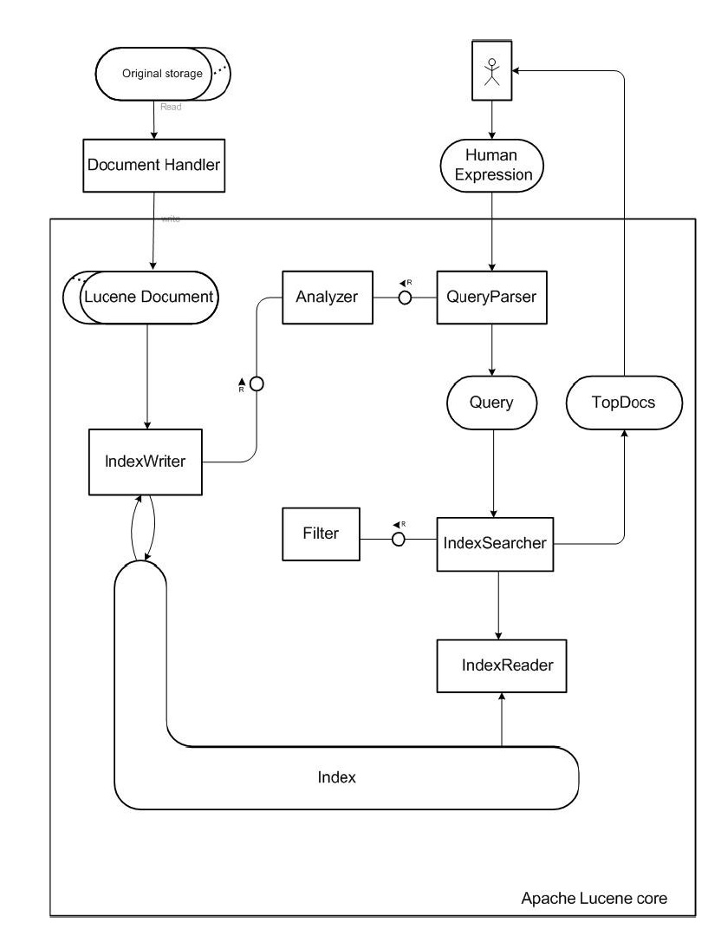
Lucene Architecture
Stores full text of ingested data
Can ingest ~150GB/per hour
Incremental indexing is fast as batch indexing
index size is approximately 20 to 30 % the size of the text indexed.

Slide 6
Who uses Lucene: Technologies and Orgs/
Apache SOLR (Used by OMS Operational Insights)
Elastic Search (everybody uses this)
CIteSeerX
Apple
7digital (digital media)
Comcast
Disney
Basically everybody either directly or indirectly…

Slide 7
From Wikipedia…
While suitable for any application that requires full text indexing and searching capability, Lucene has been widely recognized for its utility in the implementation of Internet search engines and local, single-site searching.
At the core of Lucene's logical architecture is the idea of a document containing fields of text. This flexibility allows Lucene's API to be independent of the file format. Text from PDFs, HTML, Microsoft Word, as well as many others can all be indexed as long as their textual information can be extracted.
Image indexing is not supported.

Slide 8
Lucene Query Language: Keyword Matching
Search for word "­foo­" in the title file
title: foo
Search for phrase "foo bar" in the title field
title: "foo bar"
Search for phrase "foo bar" in title field AND the phrase "­quick fox" in body field.
title­:"foo bar" AND body:"quick fox"
Search for either the phrase "foo bar" in the title field AND the phrase "­quick fox" in the body field, or the word "­fox­" in the title field.
(title:"foo bar" AND body:"quick fox") OR title:fox
Search for word "­foo­" and not "­bar­" in the title field.
title:foo -title­:bar

Slide 9
Lucene Query Language: Wildcard Matching
Search for any word that starts with "­foo­" in the title field.
title­:foo*
Search for any word that starts with "­foo­" and ends with bar in the title field.
title­:fo­o*bar

Slide 10
Demo

Slide 11
Conclusions
Lucene is cool.
Possibilities are mindless^h^h^hendless.

